Slide 1
PROBABILITY

Slide 2

Review
I. What’s in last lecture?
Descriptive Statistics – Numerical Measures.
II. What's in this and the next lectures?
Experiment, Event, Sample space, Probability, Counting rules, Conditional probability, random variables, mean, variance.

Slide 3
Descriptive and Inferential Statistics
Statistics can be broken into two basic types:
Descriptive Statistics
We have already learnt this topic
Inferential Statistics
Methods that making decisions or predictions about a population based on sampled data.
What are in next Chapters?
Probability

Slide 4
Why Learn Probability?
Nothing in life is certain. In everything we do, we gauge the chances of successful outcomes, from business to medicine to the weather
A probability provides a quantitative description of the chances or likelihoods associated with various outcomes
It provides a bridge between descriptive and inferential statistics
Probability
Population
Sample
Statistics

Slide 5
What is Probability?
Previously, we used graphs and numerical measures to describe data sets which were usually samples.
We measured “how often” using
Relative frequency = f/n
As n gets larger,
Sample
And “How often”
= Relative frequency
Population
Probability

Slide 6
Basic Concepts
An experiment is the process by which an observation (or measurement) is obtained.
An event is an outcome of an experiment, usually denoted by a capital letter.
  The basic element to which probability is applied
  When an experiment is performed, a particular event either happens, or it doesn’t!

Slide 7
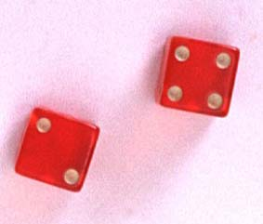
Experiments and Events
Experiment: Record an age
  A: person is 30 years old
  B: person is older than 65
Experiment: Toss a die
  A: observe an odd number
  B: observe a number greater than 2

Slide 8
Basic Concepts
Two events are mutually exclusive if, when one event occurs, the other cannot, and vice versa.
Experiment: Toss a die
  A: observe an odd number
  B: observe a number greater than 2
  C: observe a 6
  D: observe a 3
Not Mutually Exclusive
B and C?
B and D?
Mutually Exclusive

Slide 9
Basic Concepts
An event that cannot be decomposed is called a simple event.
Denoted by E with a subscript.
Each simple event will be assigned a probability, measuring “how often” it occurs.
The set of all simple events of an experiment is called the sample space, S.

Slide 10

Example
The die toss:
Simple events: Sample space:
1
E₁
E₂
E₃
E₄
E₅
E₆
S ={E₁, E₂, E₃, E₄, E₅, E₆}
2
S
3
E₁
E₃
4
E₅
5
E₂
E₆
E₄
6

Slide 11
Basic Concepts
An event is a collection of one or more simple events.
S
E₁
E₃
The die toss:
  A: an odd number
  B: a number > 2
A
E₅
B
E₂
E₆
E₄
A ={E₁, E₃, E₅}
B ={E₃, E₄, E₅, E₆}

Slide 12
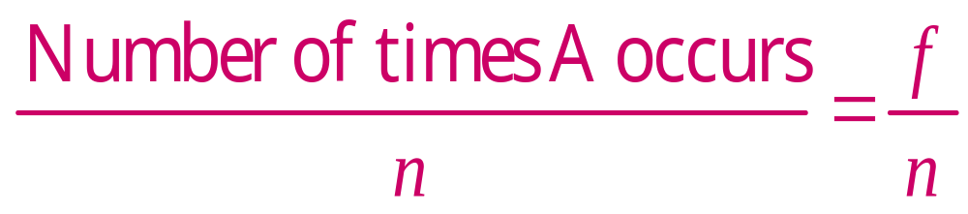
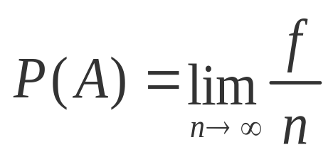
The Probability of an Event
The probability of an event A measures “how often” A will occur. We write P(A).
Suppose that an experiment is performed n times. The relative frequency for an event A is
If we let n get infinitely large,

Slide 13
The Probability of an Event
P(A) must be between 0 and 1.
  If event A can never occur, P(A) = 0. If event A always occurs when the experiment is performed, P(A) =1.
The sum of the probabilities for all simple events in S equals 1.
The probability of an event A is found by adding the probabilities of all the simple events contained in A.

Slide 14
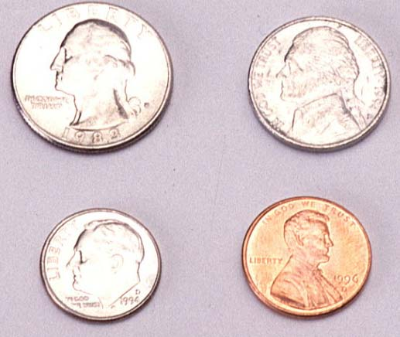
Finding Probabilities
Probabilities can be found using
  Estimates from empirical studies
  Common sense estimates based on equally likely events.
Examples:
  Toss a fair coin.
P(Head) = 1/2
Suppose that 10% of the U.S. population has red hair. Then for a person selected at random,
P(Red hair) = .10

Slide 15
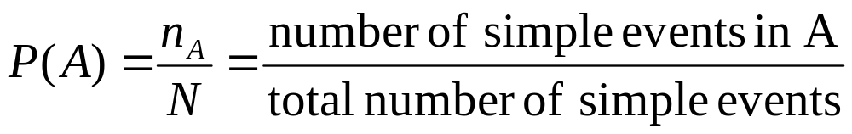
Using Simple Events
The probability of an event A is equal to the sum of the probabilities of the simple events contained in A
If the simple events in an experiment are equally likely, you can calculate

Slide 16
Example 1
Toss a fair coin twice. What is the probability of observing at least one head?
1st Coin 2nd Coin E_{i} P(E_{i})
H
HH
1/4
1/4
1/4
1/4
P(at least 1 head)
= P(E₁) + P(E₂) + P(E₃)
= 1/4 + 1/4 + 1/4 = 3/4
H
T
HT
H
TH
T
T
TT

Slide 17
Example 2
A bowl contains three Marbles, one red, one blue and one green. A child selects two Marbles at random. What is the probability that at least one is red?
1st M&M 2nd M&M E_{i} P(E_{i})
m
RB
1/6
1/6
1/6
1/6
1/6
1/6
m
m
RG
P(at least 1 red)
= P(RB) + P(BR)+ P(RG) + P(GR)
= 4/6 = 2/3
m
BR
m
m
BG
m
GB
m
m
GR

Slide 18
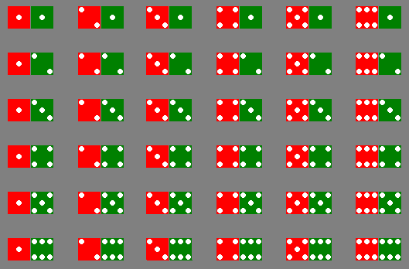
Example 3
The sample space of throwing a pair of dice is

Slide 19
Example 3
Event | Simple events | Probability
Dice add to 3 | (1,2),(2,1) | 2/36
Dice add to 6 | (1,5),(2,4),(3,3), (4,2),(5,1) | 5/36
Red die show 1 | (1,1),(1,2),(1,3), (1,4),(1,5),(1,6) | 6/36
Green die show 1 | (1,1),(2,1),(3,1), (4,1),(5,1),(6,1) | 6/36

